Slide 1
AI Camp: Introduction to AI
Unlimited Distribution
Ted Nowak
Data Scientist at Pacific Northwest National Lab
Notes:
Image: Abstract Data Visualization – Stock Photo

Slide 2
Talk Outline
What is AI?
What is Deep Learning?
What are some applications of AI?
What are current challenges in AI?
Ask Me Anything / Q and A
Questions are welcome at all times! Please interrupt!

Slide 3
What is AI?
Notes:
Pause – ask audience if they can define AI?

Slide 4
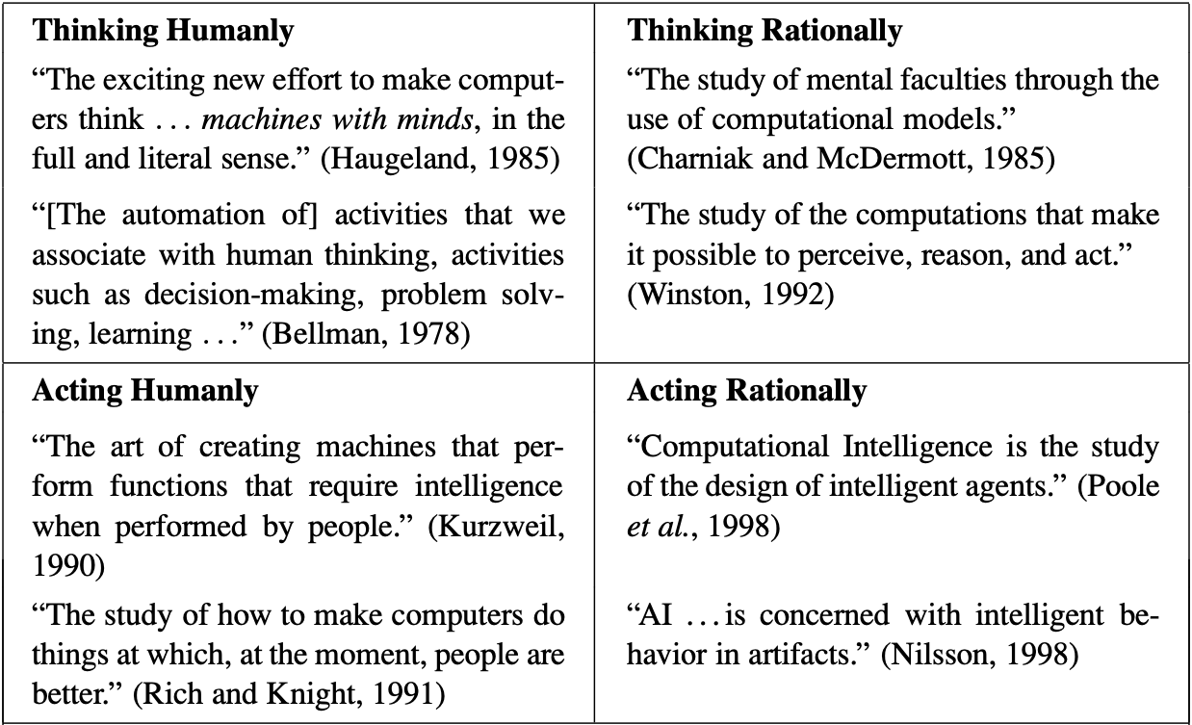
Definitions of Artificial Intelligence
Russell and Norvig: Artificial Intelligence: A Modern Approach. 2010
Notes:
Start with intimidating table of text with choice definitions of AI
- Captures the forces at play: is it about thinking or acting? Is it about being as good as humans, or been perfectly logical (rational)?

Slide 5

Foundations of AI
Pillars of AI:
Artificial Intelligence
Philosophy
Economics
Neuroscience
Computer Engineering
Linguistics
Control Theory
Mathematics
Psychology
Notes:
There’s no clear definition in part because so many people and fields contribute to AI
Aristotle – formal logic through syllogisms in 350BC
Golgi – study of neurons 1900’s
Cognitive psychology – 1950s
Von Neumann – decision theory 1950s
I’d argue it’s a central question to humanity:
How does X work
Can I make X?
Where humanity itself is the most complex thing we can think of (but also could it be better than us?)

Slide 6
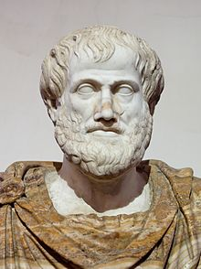
What is AI?
Artificial Intelligence
Philosophy
Economics
Neuroscience
Computer Engineering
Linguistics
Control Theory
Mathematics
Psychology
350 BC: Formal Logic
1550 AD: Probability
1944 AD: Decision Theory
1943 AD: Knowledge Representations
1930 AD: Neurons
Notes:
Stemming from:
Aristotel: formal logic and reasoning
Cardano: probability (mathematics in the face of uncertainty)
Von Neumann: utility and decision theory (making decisions that optimize returns)
Craik: cognitive psychology and knowledge representations
Ramon y Cajal: mapping brain’s neuronal structures

Slide 7
The Coining of “Artificial Intelligence”
“We propose that a 2 month, 10 man study of artificial intelligence be carried out during the summer of 1956 at Dartmouth College in Hanover, New Hampshire. The study is to proceed on the basis of the conjecture that every aspect of learning or any other feature of intelligence can in principle be so precisely described that a machine can be made to simulate it. An attempt will be made to and how to make machines use language, form abstractions and concepts, solve kinds of problems now reserved for humans, and improve themselves. We think that a significant advance can be made in one or more of these problems if a carefully selected group of scientists work on it together for a summer.”
Notes:
Despite millenia of questioning and fields of study the term artificial intelligence is rather new – coined in 1956

Slide 8
A Timeline of AI
Deep Neural Networks become state of the art
Multi-layered Perceptron is invented
Neural Networks are invented
Backpropagation is invented
Nearly all British government funding for AI research is cut
DARPA Grand Challenge ushers in AVs
Dartmouth Workshop
Shakey the robot
All US gov. funding for machine translation is cut
Bayesian NNs are invented
Support Vector Machines are invented
1956
1967
1986
2012
The “Look, ma, no hands!” era
“The vodka is good but the meat is rotten”
“AI is the new electricity.”
AI Winter
Notes:
Russian translation of biblical phrase “the spirit indeed is willing, but the flesh is weak” -> “the vodka is good but the meat is rotten”

Slide 9
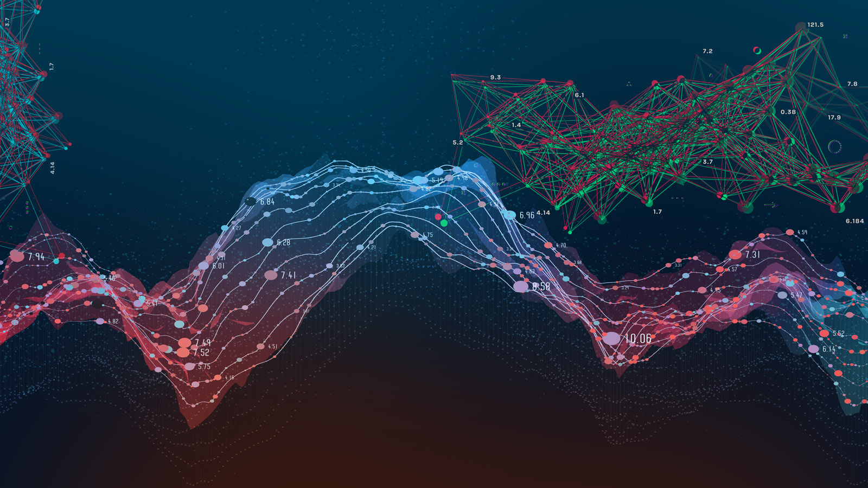
So what is AI?
Knowledge Representation
Planning
Deduction, Problem Solving
Perception and Computer Vision
Artificial Intelligence
Social Intelligence
Machine Learning
Natural Language Processing
Robotics

Slide 10
So what is AI?
Knowledge Representation
Planning
Deduction, Problem Solving
Perception and Computer Vision
Artificial Intelligence
Social Intelligence
Machine Learning
Natural Language Processing
Robotics

Slide 11
Artificial Intelligence
Artificial Intelligence
Machine Learning
Deep Learning
Notes:
Artificial Intelligence as a field has been around the longest. Refers to anything that allows a compute to mimic a human. This can be machine learning or logic, association rules, decision trees, etc.
Machine Learning using statistical techniques where computers can improve with experience / more data
Deep Learning allows for hierarchical representations of data where the algorithm learns both the output and the features themselves

Slide 12
Machine Learning
“[ML uses] algorithms and statistical models to analyze and draw inferences from patterns in data”
(some) Popular Methods
  Linear-Logistic Regression
  Random Forests
  Support Vector Machines
  Bayesian Models
Artificial Intelligence
Machine Learning
Deep Learning
Notes:
Artificial Intelligence as a field has been around the longest. Refers to anything that allows a compute to mimic a human. This can be machine learning or logic, association rules, decision trees, etc.
Machine Learning using statistical techniques where computers can improve with experience / more data
Deep Learning allows for hierarchical representations of data where the algorithm learns both the output and the features themselves

Slide 13
Deep Learning
Subset of ML which extend previous neural network approaches, made applicable with the increase in available compute
Neural networks are made up of successive layers
“Deep” as in more layers
Artificial Intelligence
Machine Learning
Deep Learning

Slide 14
Deep Learning
Notes:
Pause – ask audience if they can define AI?

Slide 15
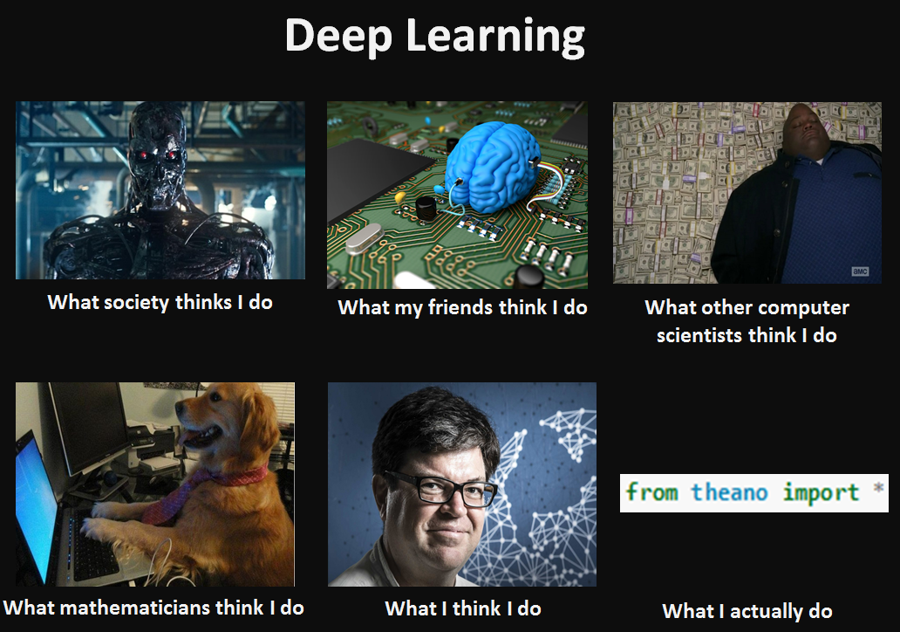
Notes:
Is there a new version of this?

Slide 16
What is a Neural Network?
A neural network is a type of machine learning algorithm where individual computational units (neurons) have weighted connections to each other within a network
Notes:
TODO – Zach: Add in equation for this slide

Slide 17

What is a Neural Network?
A neural network is a type of machine learning algorithm where individual computational units (neurons) have weighted connections to each other within a network
Inputs
Weighted sum/ Dot product
Non-Linearity
Bias term
Learned weights
Notes:
TODO – Zach: Add in equation for this slide DONE

Slide 18
What is “Deep Learning”?
A deep neural network is a multi-layer neural network
Hierarchical representations of data are learned
Learned weights
Nonlinearity
Matrix Multiplication
Notes:
Depth: Number of layers in the model
AlexNet (2012): 8 layers
VGG (2014): 16 and 19 layers
Very Deep Residual Network (2016): 1,202 layers
Out-performed by their 152 layer model
Width: Number of nodes within a layer
AlexNet: 62M total parameters
VGG16: 138M
ResNet-1202: 19.4M

Slide 19

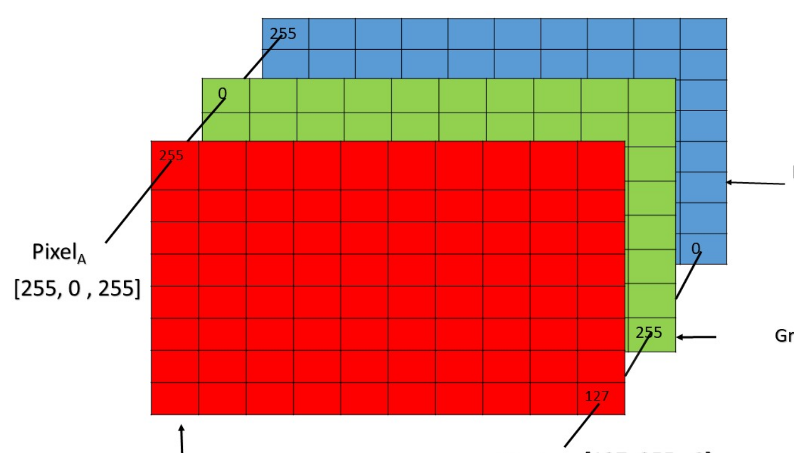
Deep Learning – Key Concept
Learned function approximation
For example vertices of a box and a number representing object class
Learn to map them to other numbers
Image are just arrays of numbers
cat
Deep Neural Network
(some crazy function)
Scoring Function
(200, 200, 3) = 120,000 parameters
Update model weights (b/c differentiability + chain rule)
Backpropagation

Slide 20
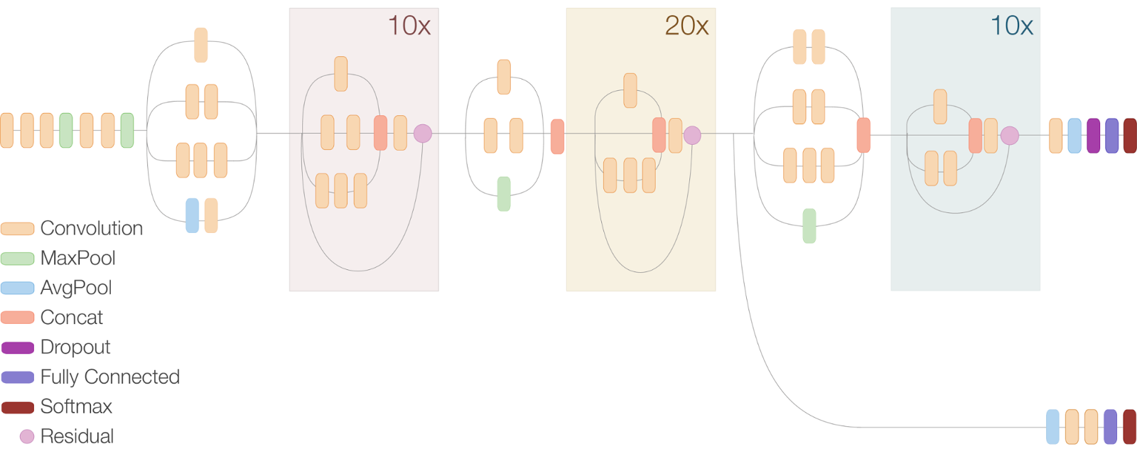
What Makes Deep Learning “Deep”?
Inception V3 (2014)

Slide 21
How deep is “Deep”?
Wu Dao
GPT-3
Neurons in human brain
Resnet-152
GPT-1
GPT-2
Inception v3

Slide 22
Why Deep Learning?
Deep learning can help to break the “soft barriers”

Slide 23
<- What was possible in 2014 isn’t the same as what’s possible today

Slide 24
Why Now?
More data
More available computing (GPUs)
Better techniques
  Optimizers
  Schedulers
Open-source tools and software
Notes:
TODO: Better visuals?

Slide 25

Software Frameworks
Deep learning frameworks provide the tools needed to implement deep neural networks
We don’t have to reinvent the wheel!
The community is coalescing around a couple major software libraries
  Enables sharing of models/methods
  Driving faster research innovation
https://pytorch.org
https://www.tensorflow.org/
Notes:
We could add HuggingFace, MMDetection, Detectron2, Skorch, FLAX

Slide 26
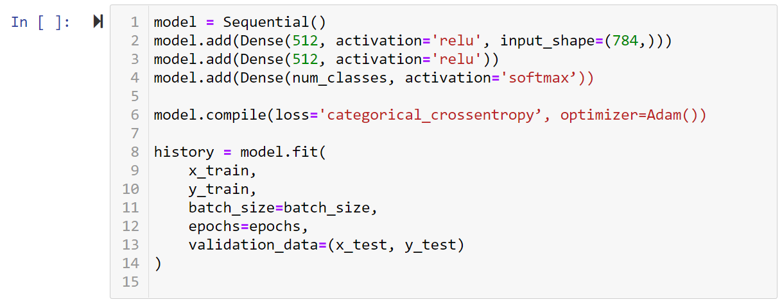
Can be as easy as…
Notes:
TODO – Zach: Make this look like code.

Slide 27
Applications of AI

Slide 28

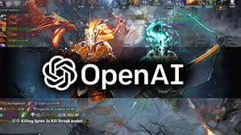

What can we do with Deep Learning?
Machine translation
Speech understanding
Image recognition
Question answering systems
Autonomous systems
Natural language processing (NLP)
Game playing

Slide 29











Deep Learning on Images
Input
Task
Output
yes
no
no
Classification
no
no
no
Cat
Object Detection
Cat
Semantic Segmentation
Notes:
Imagenet: total images > 14 million, >21 thousand categories
Competition images = 1000 categories, 1.2 million training images
Highlight the difference between these applications and the first couple ML examples
The input is (mostly) raw instead of being engineered features
The datasets are much bigger (in terms of #examples AND in terms of # of features per input e.g. hundreds or thousands of pixel values per image)
3) Complex tasks

Slide 30

Deep Learning on Text
Tasks:
Classification
Generation
Conversation
Transformation/Translation/Code Generation
Summarization
Completion
Factual Responses
GPT3 to automatically generate website HTML

Slide 31

Reinforcement Learning
Goal:
Learning actions through trial and error and some notion of reward.
Tasks:
- Game playing
Robotic Motion
Puzzle solving

Slide 32
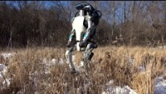
Robotics
Goal:
Developing intelligent agents (actors).
Tasks:
Optimal control
Robot perception
Active learning
Decision planning
Motion planning
Manipulation planning
Navigation
Localization
Human Machine Interaction and Teaming

Slide 33
Challenges in AI

Slide 34
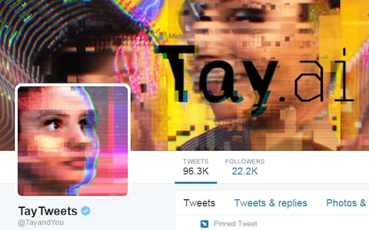
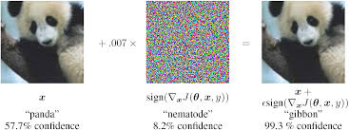
Challenges
Generalized AI
Adversarial attacks
Compute and Data Hungry
Constrained Learning
Ethical AI
(many more)

Slide 35
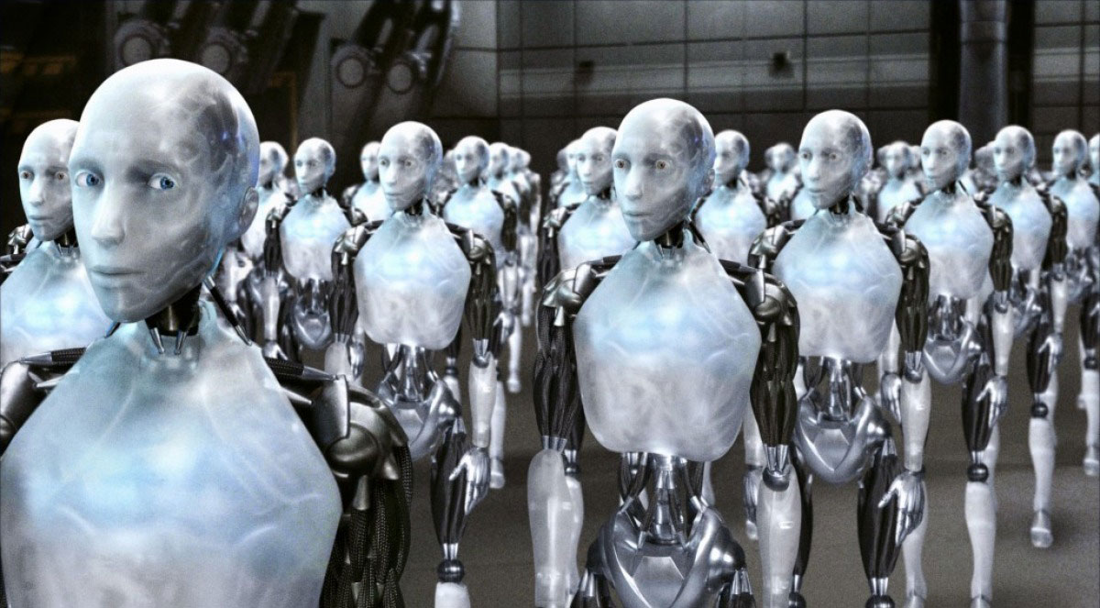
Generalized AI
Models are trained for a certain task
Robots are designed to operate in a certain environment
How can a single agent do it all?

Slide 36
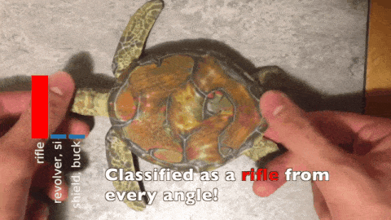
Adversarial Machine Learning
Athalye, Engstrom, Ilyas, et. Al. - Synthesizing Robust Adversarial Examples. 2017

Slide 37
Big Compute and Big Data
“Converting this energy consumption in approximate carbon emissions and electricity costs, the authors estimated that the carbon footprint of training a single big language model is equal to around 300,000 kg of carbon dioxide emissions. This is of the order of 125 round-trip flights between New York and Beijing, a quantification that laypersons can visualize.”
Dhar, P. The carbon impact of artificial intelligence. Nat Mach Intell 2, 423–425 (2020). https://doi.org/10.1038/s42256-020-0219-9

Slide 38
Constrained/Physical AI
Microsoft Tay learned to be racist via interaction with users on twitter

Slide 39
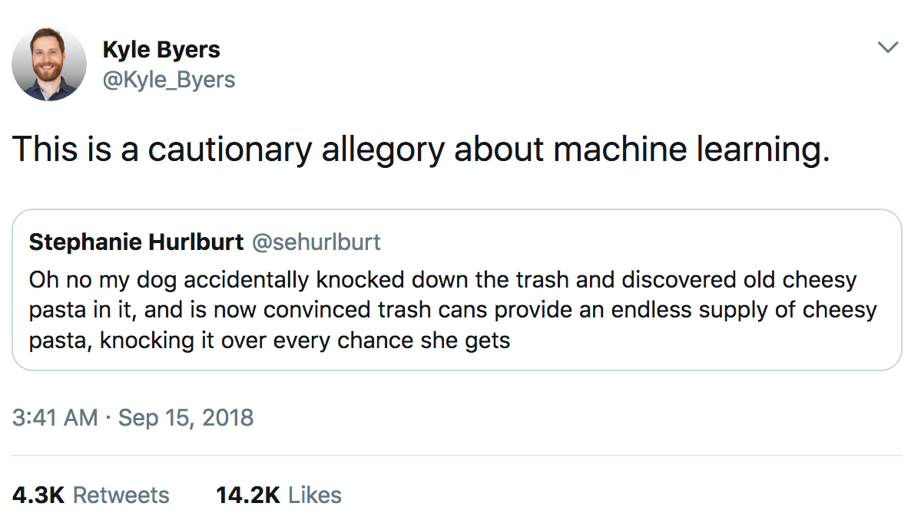
Ethical AI

Slide 40
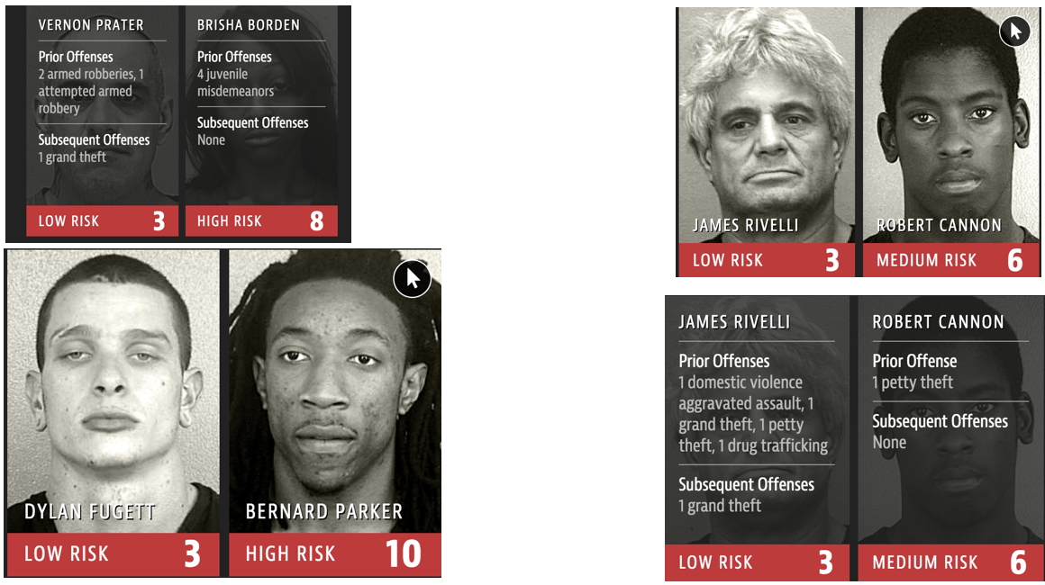
Ethical AI
‘COMPAS Software Results’, Julia Angwin et al. (2016)

Slide 41
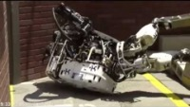
Ask me anything!

